Slide 1
Experiment design

Slide 2
Artficial Natural
Prime-target relation: Same word
Fixation 1000ms
Artficial Natural
Mask 270ms
Artficial Natural
Mask 30ms
Artficial Natural
RADIO
Prime 30ms
Artficial Natural
Mask 30ms
Artficial Natural
Time
radio
Target + Categorization 500ms
RADIO PHONE
Recognition
How well did you see the first stimuli?
On a scale of 1-4
PAS
1 2 3 4

Slide 3
Artficial Natural
Prime-target relation: Different word
Fixation 1000ms
Artficial Natural
Mask 270ms
Artficial Natural
Mask 30ms
Artficial Natural
CLOUD
Prime 30ms
Artficial Natural
Mask 30ms
Artficial Natural
Time
radio
Target + Categorization 500ms
CLOUD TIGER
Recognition
How well did you see the first stimuli?
On a scale of 1-4
PAS
1 2 3 4

Slide 4
Setup

Slide 5
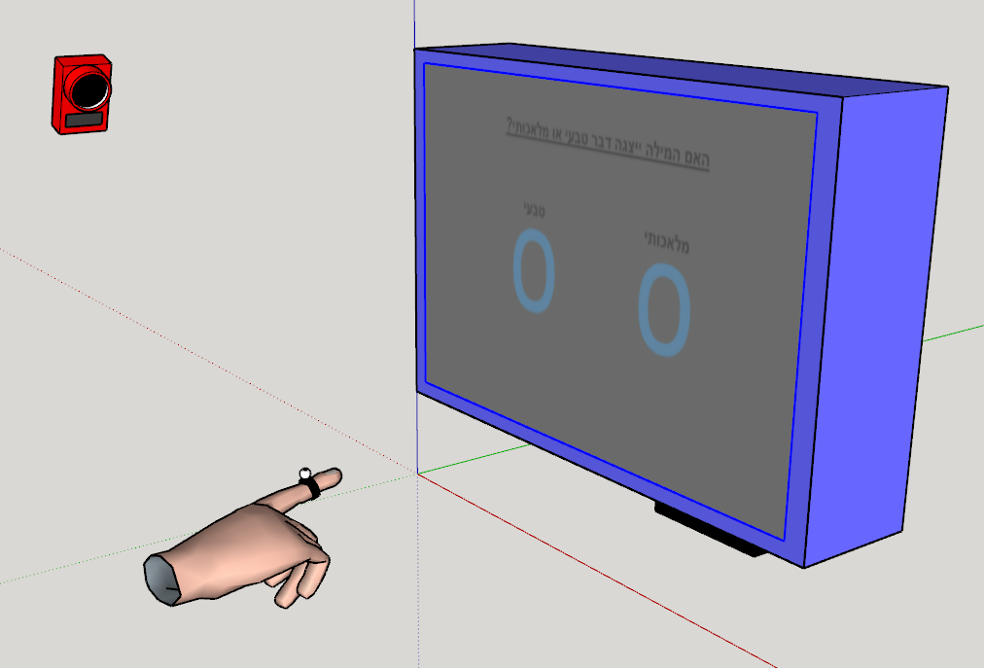

Slide 6
Single Subjects Results
Blue = congruent prime and target
Red = incongruent
Thick lines = average trajectory, separated for reaches to the left
and to the right half of the screen.

Slide 7
Subject 25

Slide 8
Subject 22
Congruent
Incongruent

Slide 9
Subject 19

Slide 10
Subject 18

Slide 11
Subject 17

Slide 12
Subject 16

Slide 13
Subject 14

